Slide 1
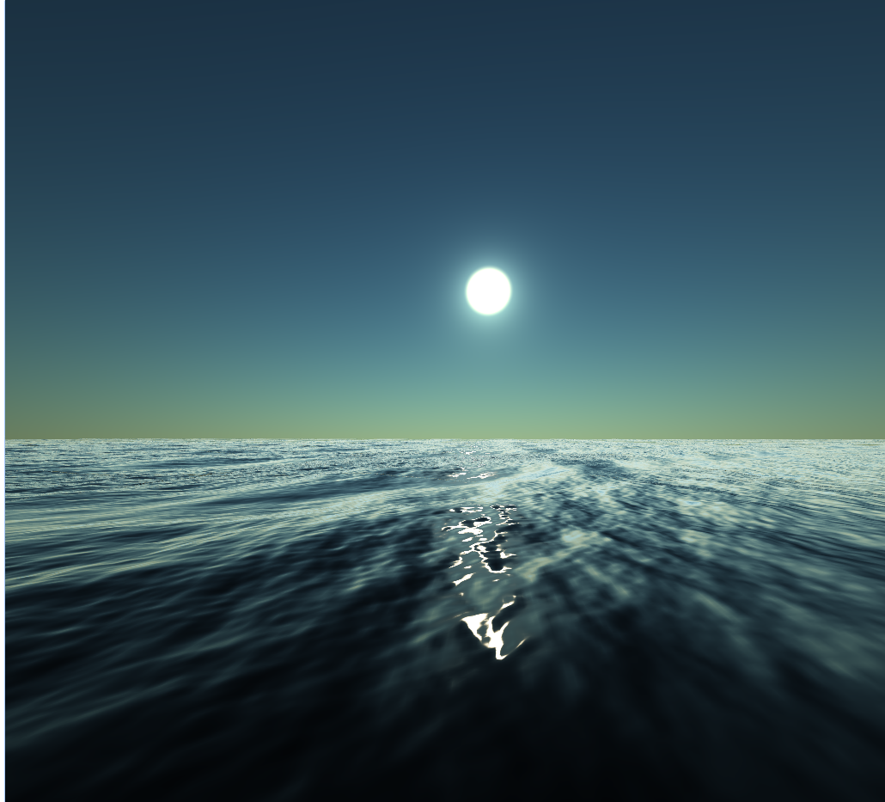
WebGL Ocean Simulation and Rendering based on FFT
http://guanyuhe.com/oceanshader/water.html
Hao Wu, Guanyu He

Slide 2

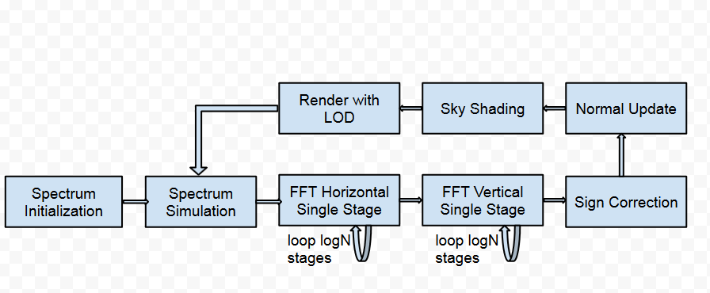
Technical Approach
Simulation and rendering pipeline

Slide 3
Progress So Far
Simulation
Height field spectrum initialization
Spectrum simulation
Fast Fourier Transform (FFT)
Weights and indices texture computation
2 dimensional FFT on WebGL using GPGPU
Rendering
Ocean surface rendering
Physically based sun and sky
Infinite ocean tiling with LOD
HTML user interface
Control sun position and sky rendering parameters
Control wind speed and direction

Slide 4
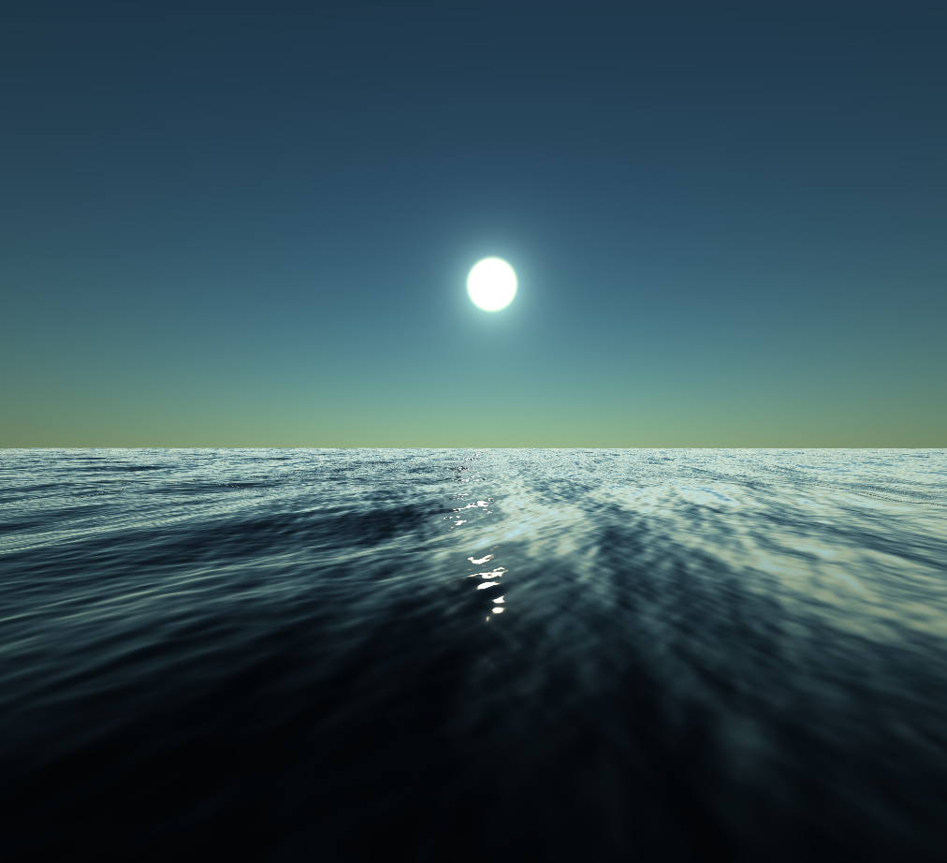
Demo

Slide 5
Future work
Seamless tiling
Break repeated pattern intrinsic to FFT

